Slide 1
Subtitles
Adrien PAJOT
Nicolas ROGER
Géraldine Zanolli
Aimery THOMAS

Slide 2
Goal
The objective of this script is to download a subtitle for a series episode using the pesistream API and the website addic7ed.

Slide 3
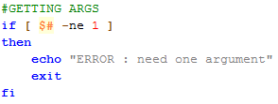

Code comments
We check the script is executed with an argument:
Then we check the argument match to a folder path thanks to “-d”:
3

Slide 4


Code comments
We create a list of different video files extensions:
We create a loop to process all files in the folder:
We split the file’s name in two parts. The name without the extention and the extension:
4

Slide 5
Code comments
We verify that the selected file is a video by checking if its extension match with one of the list’s values defined earlier:
We check the subtitle file does not already exist:
We execute a GET request thanks to the Pesistream API:
5

Slide 6
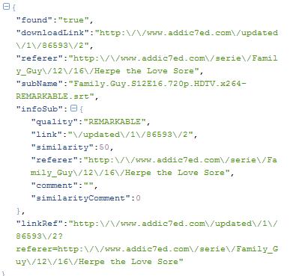
Code comments
Here is an example of the previous request result:
6

Slide 7


Code comments
We use a function to get a specific parameter:
The first line gets the parameter's value and the second one removes unnecessary characters.
We use this function to get the necessary parameters to download the subtitle file:
7

Slide 8
Code comments
We check if the subtitle file was found:
We download the file ($subName) in the directory ($path) using the download link and the referer:
8

